Slide 1
UNIT 2 Word Level Analysis

Slide 2
What are N-grams?
An N-gram is a continuous sequence of N items (usually words) from a text.
Example: For sentence 'I love NLP':
- Unigrams: I, love, NLP
- Bigrams: I love, love NLP
- Trigrams: I love NLP

Slide 3

Mathematical Model for N-grams Definition
For sequence of words w1,w2,.......wm:
Chain Rule:
Example for bigram model:
P(I love NLP) ≈ P(I) × P(love|I) × P(NLP|love)

Slide 4
Example Corpus
Corpus: “I love NLP. I love AI. I study NLP.”
Vocabulary = {I, love, NLP, AI, study}
We will compute unigram and bigram probabilities from this corpus.

Slide 5
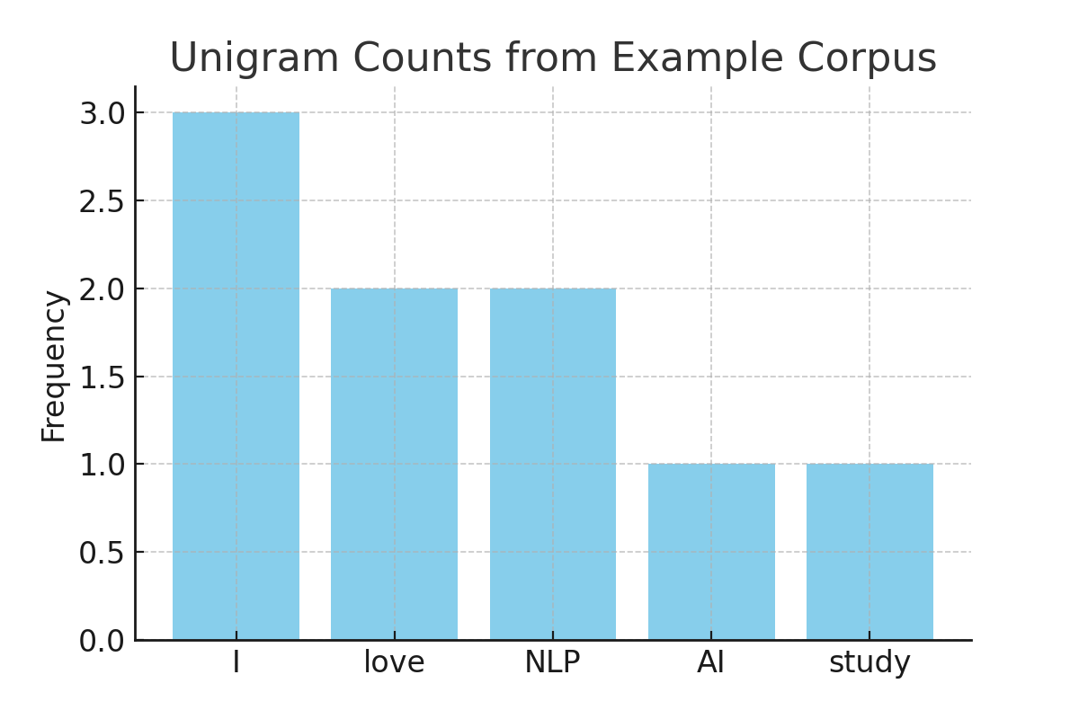
Unigram Frequency Distribution
Word | Count
I | 3
Love | 2
NLP | 2
AI | 1
study | 1

Slide 6
Unigram Probability Example
Corpus: “I love NLP. I love AI. I study NLP.”
Total tokens = 3+2+2+1+1=9
P(I)=3/9=0.33
P(love)=2/9≈0.22
P(NLP)=2/9≈0.22
P(AI)=1/9≈0.11
P(study)=1/9≈0.11

Slide 7
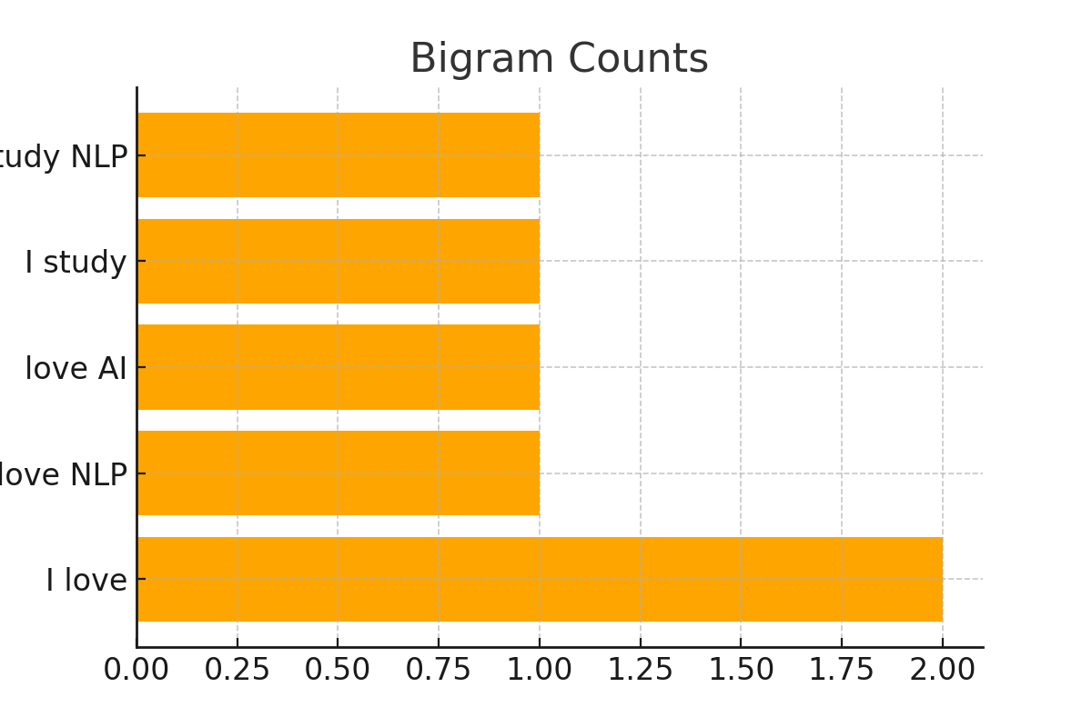
Bigram Counts Visualization
Corpus: “I love NLP. I love AI. I study NLP.”
Bigram | Count
I Love | 2
Love NLP | 1
Love AI | 1
I study | 1
Study NLP | 1

Slide 8
Bigram Probability Example
Corpus: “I love NLP. I love AI. I study NLP.”
Count("I love") = 2; Count("I study") = 1;
total bigrams starting with "I" = 3.
P(love∣I)=2/3≈0.67
P(study∣I)=1/3≈0.33
P(AI∣I)=0

Slide 9
Zero-Probability Problem
If a bigram never appears in the training corpus → probability = 0.
Example: P(AI∣I)=0 → makes entire sentence probability zero.
This motivates smoothing methods (to handle unseen N-grams).

Slide 10
Evaluating N-grams
Why Evaluate N-grams?
We need to know how well an N-gram model predicts unseen sentences.
Evaluation helps compare models (e.g., unigram vs. bigram).
Main metrics: Cross-Entropy and Perplexity.

Slide 11

Cross-Entropy Definition
In Natural Language Processing (NLP), cross-entropy is a measure of how well a probabilistic model predicts a sample of data (typically sequences of words).
Cross-Entropy measures the average uncertainty of predictions:
Lower H(p) → better prediction.

Slide 12
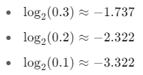
Cross-Entropy Example
Test Words: ["the", "cat", "sat", "on", "the", "mat"]”
Probabilities: [0.3, 0.2, 0.1, 0.1, 0.3, 0.3]

Slide 13
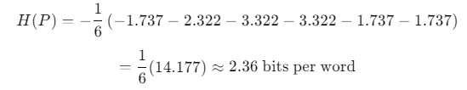

Slide 14

What is Perplexity?
Perplexity is the exponential of the cross-entropy. It represents the average branching factor — how many likely choices the model considers at each step.
Perplexity (PP) measures how “confused” the model is:
Lower PP means better performance.

Slide 15
Perplexity Example
From previous example:
we have H=2.36
PP=2^(2.36)≈5.18
So the model is as "confused" as if it had to choose between about 5.18 equally likely options at each word

Slide 16
Why Perplexity is Useful
Standard metric for comparing language models.
Allows evaluation without manual inspection.
Lower perplexity usually correlates with better real-world performance.

Slide 17
Limitations of Perplexity
PP depends on the test set; results vary with data size.
Models with artificially low PP may not generalize.
Cannot capture semantic or grammatical correctness.

Slide 18
Cross-Entropy vs. Perplexity
Cross-Entropy is measured in bits per word.
Perplexity is the exponentiated form: easier to interpret.
Both are equivalent measures; they differ in readability.

Slide 19
Data Sparsity Impact
Many N-grams in test data may not appear in training data.
Leads to zero probabilities and inflated perplexity.
This is why smoothing is essential.

Slide 20
Transition to Smoothing
We’ve seen that unsmoothed models assign zero probabilities to unseen sequences.
Smoothing methods fix this by redistributing probability mass.
Next: Laplace, Good-Turing, and Kneser-Ney smoothing.

Slide 21
Why Do We Need Smoothing?
Unsmoothed models give zero probability to unseen N-grams.
Real language data is sparse; many possible word combinations never appear in training.
Smoothing adjusts counts to avoid zero probabilities.

Slide 22

Laplace (Add-1) Smoothing
Simplest smoothing technique:
V = vocabulary size.

Slide 23
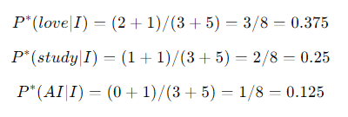
Laplace Example: Bigram
Example corpus: “I love NLP. I love AI. I study NLP.”
Vocabulary V=5, total bigrams after “I” = 3.
Count(love|I)=2, Count(study|I)=1, Count(AI|I)=0.

Slide 24
Laplace Probability Distribution
Bigram | Raw count | Smoothed count | Smoothed Prob
I love | 2 | 3 | 0.375
I study | 1 | 2 | 0.25
I AI | 0 | 1 | 0.125
I NLP | 0 | 1 | 0.125
I others | 0 | 1 | 0.125

Slide 25
Laplace: Pros and Cons
Pros:
Easy to implement.
Eliminates zero probabilities.
Cons:
Overestimates unseen events.
Reduces probability accuracy for frequent events.

Slide 26

Good-Turing Smoothing
Good-Turing smoothing is designed to adjust the observed frequency counts of N-grams to better estimate probabilities for unseen events in language modeling.
Re-estimate the count of events seen c times using:
c∗ is the adjusted count (expected count)
Nc is the number of N-grams that occur exactly c times
Nc+1 is the number of N-grams that occur exactly c+1 times

Slide 27
Good-Turing Probability
Adjusted Probability: P(w)=c∗​/N
Where N is the total number of tokens (before smoothing)

Slide 28
Example 1 – Simple Word Frequency Case
Suppose you have the following word frequency from a tiny corpus:
Word | Count
"cat" | 3
"dog" | 2
"rat" | 2
"bat" | 1
"cow" | 1
(others) | 0

Slide 29
Step 1: Compute Nc
Count c | Nc
1 | 2
2 | 2
3 | 1

Slide 30



Step 2: Apply Good-Turing for observed counts
For "dog" and "rat" (c = 2):
For "bat" and "cow" (c = 1):
For unseen words (c = 0):

Slide 31
Example 2: Good-Turing on Trigram Frequencies
Suppose we have the following trigram counts from a toy corpus:
Trigram | Count c
"the cat sat" | 3
"cat sat on" | 2
"sat on the" | 2
"on the mat" | 1
"the mat barked" | 1
(many others) | 0

Slide 32

Step 1: Tabulate Nc​ — the number of trigrams with frequency c
Count c | Nc
1 | 2
2 | 2
3 | 1
Step 2: Compute Adjusted Counts c∗ using Good-Turing Formula

Slide 33


For "on the mat" and "the mat barked" (c = 1):
For "cat sat on" and "sat on the" (c = 2):

Slide 34
Step 3: Adjusted Probabilities:
Assume total original trigram tokens
N=3+2+2+1+1=9
Now compute probabilities:
P∗(on the mat)=2/9​=0.222
P∗(cat sat on)=1.5/9=0.167
P∗(the cat sat)=3/9=0.333

Slide 35
Good-Turing Pros & Cons
Pros:
More accurate for unseen events than Laplace.
Based on statistical evidence.
Cons:
Requires reliable Nc counts.
More complex to implement.

Slide 36
Transition to Interpolation and Backoff
Smoothing fixes zero probabilities.
But we can improve further by combining models.
Next: Interpolation and Backoff techniques.

Slide 37
What is Interpolation?
Interpolation combines probabilities from multiple N-gram models (unigram, bigram, trigram).
It assigns a weighted sum of probabilities:
λ1​+λ2​+λ3​=1.

Slide 38
Why Use Interpolation?
Higher-order N-grams are more accurate but sparse.
Lower-order models cover unseen cases.
Interpolation ensures no probability is zero and improves accuracy.

Slide 39
Interpolation Example
We use:
Assume: λ3​=0.5, λ2​=0.3, λ1​=0.2
Let’s compute P(NLP | I love)
Trigram P(NLP ∣ I love)=1/2=0.5
Bigram P(NLP ∣ love)=2/3≈0.667
Unigram P(NLP)=3/12=0.25
Pinterp(NLP | I love) = (0.5x0.5) + (0.3x0.667) + (0.2x0.25) = 0.50
Even if trigram was 0, interpolation would still produce a probability using the other n-grams.

Slide 40
Choosing λ Values
λ parameters are often tuned using:
Held-out data (validation set).
Expectation-Maximization (EM) algorithm for optimization.
Must ensure λ1+λ2+λ3=1

Slide 41
Backoff Concept
Backoff uses the highest-order N-gram available.
If the probability is zero, it backs off to a lower-order model:
Try trigram → if unavailable → use bigram → if unavailable → use unigram.

Slide 42

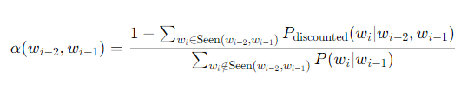
Katz Backoff Formula
Where d ----------> discount some probability for seen N-grams and back off to lower-order models.
In this α :
The numerator is the leftover probability mass after discounting observed trigrams.
The denominator is the total probability mass assigned by the lower-order model to all unseen trigrams

Slide 43
Example
Corpus: “the cat sat on the mat”
Unigrams:
C(the) = 2
C(cat) = 1
C(sat) = 1
C(on) = 1
C(mat) = 1
Total tokens = 6
Bigrams:
C(the cat) = 1
C(cat sat) = 1
C(sat on) = 1
C(on the) = 1
C(the mat) = 1
We want to calculate
PKatz​(sat∣the)

Slide 44
Step 2: Identify Seen Bigrams for “the”
From bigram counts, we know:
Seen: (the cat), (the mat)
Unseen from "the": all others (e.g., the sat, the on)
Let’s set Good-Turing discount d = 0.5 for simplicity

Slide 45
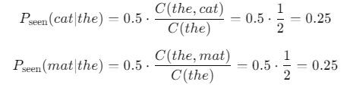
Step 3: Calculate Discounted Probabilities for Seen Bigrams
So, total assigned probability to seen bigrams = 0.25 + 0.25 = 0.5

Slide 46
Step 4: Compute Remaining Probability Mass
1 − 0.5 = 0.5 (leftover to distribute to unseen words)
Step 5: Calculate α(the)
We now back off to unigram probabilities for unseen bigrams
Let’s assume:
P(sat) = 1/6
P(on) = 1/6
P(others) = ...
Among unseen from "the", let’s say:
(the sat)
(the on)
Unseen bigrams: {sat, on} → Unigram probabilities sum = 1/6 + 1/6 = 1/3
Now compute: α(the) = 0.5/(1/3) = 1.5

Slide 47

Step 6: Compute Backoff Probability
Final Result
PKatz(sat∣the)=0.25
This means Katz assigns 0.25 probability to an unseen bigram using α and backing off to a unigram.

Slide 48
Example 2
Corpus: "data is power. data is useful”
Find the probability of P(data|is)
Tokenized: [data, is, power, data, is, useful]
Unigram Counts:
Bigram Counts:
Word | Count
Data | 2
Is | 2
Power | 1
Useful | 1
Word | Count
Data is | 2
Is powerful | 1
Is useful | 1

Slide 49

Since count(is, data) = 0, use:
Unigram probability (Maximum Likelihood Estimate):
PBO(data) = C(data)/total no. of words = 2/6 =1/3 = 0.33

Slide 50

Compute α(is)
Here for “is” word the seen bigrams are:
(is, power)
(is, useful)
Assume discounted probabilities:
Let’s assume a fixed discount d = 0.5

Slide 51
Then
P*(power | is) = d x count( is power) / count(is)
= 0.5 x ½ = 0.25
P*(useful | is) = d x count( is useful) / count(is)
= 0.5 x ½ = 0.25
Total discounted prob mass used for seen words = 0.25 + 0.25 = 0.5
Words not seen after "is" are: data

Slide 52

So,
= 0.33
Hence,
α(is) = 0.5 / 0.33 = 1.51
Therefore, PBO​(data ∣ is) = α(is) x PBO​(data) = 1.51 x 0.33
= 0.498

Slide 53
Practical Use Cases
Speech recognition: often uses backoff because it’s simpler.
Text prediction: interpolation is preferred for better accuracy

Slide 54
Word Classes
What are word classes?
Word Classes, also known as Parts of Speech (POS) or syntactic categories, are fundamental in NLP because they describe the grammatical role each word plays in a sentence.
Understanding word classes is essential for syntactic parsing, machine translation, information extraction, and many more NLP tasks
Common classes: Noun, Verb, Adjective, Adverb, Pronoun, Conjunction, Determiner, Preposition.
Example: “The quick fox jumps” →
The/Det , quick/Adj , fox/N, jumps/V.

Slide 55
Major Word Classes
Word Class | Description | Examples
Noun | Names of people, places, thing | dog, city, freedom
Pronoun | Replaces nouns | he, she, it, they
Verb | Expresses actions or states | Running, feeling
Adjective | describes noun | red, quick, large
Adverb | Describes verbs/adjectives | quickly, very, silently
Preposition | Shows relationships | in, on, under
Conjunction | Connects words/phrases | and, but, or
Determiner | Introduces nouns | a, the, this, some
Interjection | Expresses emotion | wow!, ouch!, hey!

Slide 56
Why Word Classes Matter in NLP
Task | How Word Classes Help
POS Tagging | Assigns correct tags to each word
Parsing | Builds syntactic structure trees
Named Entity Recognition (NER) | Helps in identifying proper nouns
Machine Translation | Ensures correct word order and agreement
Information Extraction | Distinguishes between objects, actions, etc.

Slide 57
Part- of-Speech Tagging
POS tagging is the process of assigning a part of speech (like noun, verb, adjective, etc.) to each word in a sentence based on its definition and context
It converts a sentence into a list of tuples, where each tuple is in the form of (word, tag).
Example:
Sentence: “She runs fast.”
Word | POS
She | Pronoun
Runs | Verb
Fast | Adverb

Slide 58
Why PoS Tagging?
What is a "Tag"?
A tag is a POS tag that signifies whether the word is a noun, adjective, verb, and so on...
Essential for syntactic parsing and semantic analysis.
Helps in applications like:
Machine translation
Speech recognition
Question answering

Slide 59
PoS Tagging Example
Sentence: “I like NLP models”
I → Pronoun
like → Verb
NLP → Noun
models → Noun

Slide 60
Example (Ambiguity):
"They refuse to permit us to obtain refuse permit“
Notice "refuse" as a Verb and "refuse" as a Noun, and "permit" as a Verb and "permit" as a Noun in different contexts.
This highlights the need for disambiguation.

Slide 61
Approaches to POS Tagging
Rule-Based POS Tagging
Stochastic (Statistical) POS Tagging
Transformation-Based Tagging (TBL)

Slide 62
Rule-based PoS Tagging
Concept:
Uses dictionaries or lexicons for adding possible tags to each word
If a word has more than one possible tag, handwritten rules are used to identify the correct tag
Rule-based Part-of-Speech (POS) tagging assigns the correct grammatical tag to each word in a sentence using:
A dictionary or lexicon (provides possible POS tags)
A set of hand-crafted linguistic rules (resolves ambiguities based on context)

Slide 63
Two-Stage Architecture:
◦ First Stage: Uses a dictionary to assign each word a list of potential parts of speech.
◦ Second Stage: Uses a large list of handwritten disambiguation rules to sort down the list to a single part of speech for each word.

Slide 64
Rule-based Example
Sentence: "The dogs bark loudly”
Lexicon:
"The" → determiner (DT)
"dogs" → noun (NN or NNS)
"bark" → noun (NN) or verb (VB)
"loudly" → adverb (RB)
Rules:
If a word follows a determiner and is plural, tag as noun plural (NNS)
If a word follows a plural noun, and can be a verb, tag as verb

Slide 65
Final tags:
The/DT
dogs/NNS
bark/VB
loudly/RB

Slide 66
Rule-based POS Tagging Examples
Example 1: "I play cricket Everyday"
◦ "play" is tagged as a Verb
Example 2: "I want to perform a play"
◦ Here, "play" is a noun rather than a verb, because it follows a determiner ("a“)
Example 3: "I want to Read a book"
◦ Rule: Det -> book (The word "book" is a Noun (NN) when preceded by a Determiner)

Slide 67
Rule-based Pros & Cons
Pros:
Transparent, interpretable.
Works without large datasets
Cons:
Hard to write rules for all cases.
Struggles with ambiguous words: “book” → noun or verb?

Slide 68
Stochastic-based POS Tagging
Models that include frequency or probability can be called stochastic
Any number of different approaches to the problem of part-of-speech tagging can be referred to as a stochastic tagger.
Uses probabilities instead of fixed rules.
Often implemented via Hidden Markov Models (HMMs).
Finds the most probable tag sequence for a sentence.

Slide 69
Approaches:
1. Word Frequency Approach:
▪ Stochastic taggers disambiguate words based on the probability that a word occurs with a particular tag
2. Tag Sequence Probability:
▪ The tagger calculates the probability of a given sequence of tags occurring
▪ Also called an N-gram approach
▪ The best tag for a given word is determined by the probability that it occurs with the N previous tags
▪ Requires a training corpus

Slide 70
Stochastic-based POS Tagging Example
Sentence: "Secretariat is expected to race tomorrow“
Ambiguity: "race" can be a Verb or a Noun
From Corpus Data:
Verbs similar to "race" (e.g., that can be preceded by "to") appear about 500 times.
Nouns similar to "race" (e.g., that can be preceded by "to") occur less frequently.
Probability:
The probability of the sequence "to verb tag" is higher than "to noun tag".
Therefore, "race" is correctly tagged as a Verb in this context.

Slide 71
Stochastic - HMM-Based PoS Tagging
Transition probability: P(tagi∣tagi−1)
Emission probability: P(wordi∣tagi)
Viterbi algorithm finds the most probable tag path.

Slide 72
HMM Formula Example
For sentence “I love NLP”:
P(tags∣words)=P(PRON)×P(love∣VERB)×P(VERB∣PRON)×…
Then choose the sequence maximizing this probability.

Slide 73
Transformation-based Tagging
It is also Known as: Brill Tagging.
Nature: An instance of transformation-based learning.
Rule-based Algorithm: It is a rule-based algorithm for automatic tagging of POS to given text.
Learning: It is a machine learning technique where rules are automatically induced from data.
Inspiration: Draws inspiration from both rule-based and stochastic taggers.
General Idea:
◦ Guess the tag of each word.
◦ Then, go back and fix the mistakes

Slide 74
How Transformation-based Learning (TBL) Works
Starting Point:
Starts with some solution to the problem.
Works in cycles
Cycle Process:
In each cycle, TBL chooses the most beneficial transformation.
◦ This chosen transformation is then applied to the problem
Stopping Condition:
The algorithm stops when the selected transformation will not add either more value or there are no more transformations to be selected

Slide 75
Transformation-based Tagging Example
Sentence: "The race was exciting“
1. Initial Tagging:
Each word is tagged based on its most frequent tag.
Example: "race" might initially be tagged as a Verb because "race" is frequently a Verb
◦ "The" - Det
◦ "race" - Verb
◦ "was" - Verb
◦ "exciting" - Adj

Slide 76
2. Transformation Rule Application:
◦ Based on training data, the model learns rules.
◦ Rule Example: "Change verb to noun if preceded by det."
◦ Applying this rule: Changes "race" from Verb to Noun, resulting in correct tagging.
"The" Det | "race" Noun (was originally Verb) | "was" Verb | "exciting" ADJ
3. Iterate until Convergence:
The model continues to apply rules iteratively, improving tagging accuracy with each application

Slide 77
Transformation Pros & Cons
Pros:
Combines rules and data-driven learning.
Better accuracy than pure rule-based
Cons:
Requires annotated corpora for training.

Slide 78
Issues in PoS Tagging
Ambiguity: Words have multiple tags (“light”: noun/verb/adjective).
Unknown words: Not present in training corpus.
Domain sensitivity: A tagger trained on news may fail on social media text.

Slide 79
Handling Unknown Words
Use suffix rules: words ending in “-ly” → adverbs.
Use capitalization: capitalized words often proper nouns.
Use morphological analysis.

Slide 80
Evaluation of PoS Taggers
Accuracy metric: Percentage of correctly tagged words.
Typical accuracy:
Rule-based: ~90%
HMM/Stochastic: 95–97%

Slide 81
PoS Tagging Example (Full Sentence)
“The cat sat on the mat.”
The/DT cat/NN sat/VBD on/IN the/DT mat/N

Slide 82
Hidden Markov Model (HMM)?
What is a Hidden Markov Model (HMM)?
An HMM is a statistical model that represents sequences where:
States are hidden (e.g., PoS tags).
Observations are visible (e.g., words).
Used widely for PoS tagging, speech recognition, and sequence labeling.

Slide 83
Components of HMM
States (S): possible tags, e.g., Noun, Verb, Det.
Observations (O): actual words in the sentence.
Transition probabilities (A): P(sj∣si) – probability of moving from one state to another.
Emission probabilities (B): P(ok∣sj) – probability of emitting a word given a tag.
Initial probabilities (π): P(s1) – starting tag probability.

Slide 84
Why Use HMM?
Words are observed; tags are hidden.
HMM models the probability of tag sequences and word emissions.

Slide 85



Bayesian Formulation
Find the most probable tag sequence t^ given a word sequence w:
Using Bayes’ Rule:
Since P(w) is constant for all tag sequences:

Slide 86



HMM Assumptions
Output Independence
Markov Assumption (Bigram):
Final Equation:

Slide 87


Transition & Emission Probabilities
Transition probability:
Example: From Brown Corpus → P(NN∣DT)=56,509/116,454= 0.49
Emission probability:
Example: P(is∣VBZ)=10073/21627​=0.47

Slide 88
Worked Example - Ambiguity of "Race"
Sentence: “Secretariat is expected to race tomorrow”
Race can be NN or VB.
Probabilities:
P(NN∣TO)=0.00047, P(VB∣TO)=0.83
P(race∣NN)=0.00057, P(race∣VB)=0.00012
Combined sequence probabilities:
With VB → 2.7×10^−7
With NN → 3.2×10^−10
Correct tag chosen: VB

Slide 89
The Viterbi Algorithm for HMM Tagging
For any model, such as an HMM, that contains hidden variables, the task of determining which sequence of variables is the underlying source of some sequence of observations is called the decoding task.
The Viterbi algorithm is perhaps the most common decoding algorithm used for HMMs, whether for part-of-speech tagging or for speech recognition

Slide 90
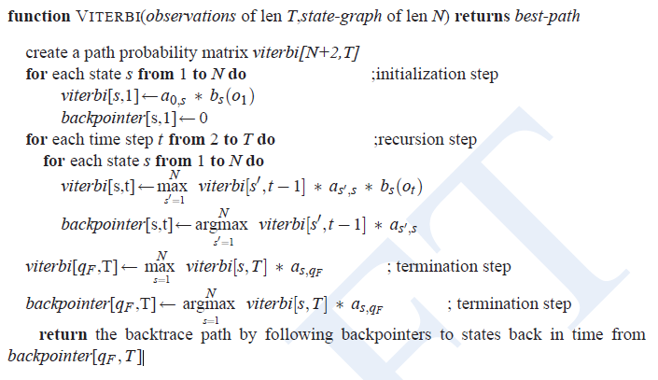
Viterbi Algorithm

Slide 91
Viterbi Algorithm
Finds the most probable tag sequence for a sentence.
Uses dynamic programming to avoid recomputing probabilities.

Slide 92
Viterbi Example
Sentence: “I saw her duck.”
Ambiguity: “duck” → noun or verb.
HMM + Viterbi chooses the most probable tag sequence:
“I/PRP saw/VBD her/PRP duck/NN” > “I/PRP saw/VBD her/PRP duck/VB”.

Slide 93
Transition to Maximum Entropy Models
HMMs are generative models.
Maximum Entropy (MaxEnt) models are discriminative models:
Focus directly on P(tag∣context) instead of joint P(tags,words)

Slide 94

What is a Maximum Entropy Model?
Logistic regression model for sequence labeling.
Uses feature functions instead of just previous tags.
Formula:
where:
t = tag, c = context,
fi = feature function,
λi = learned weights,
Z(c) = normalization factor.

Slide 95
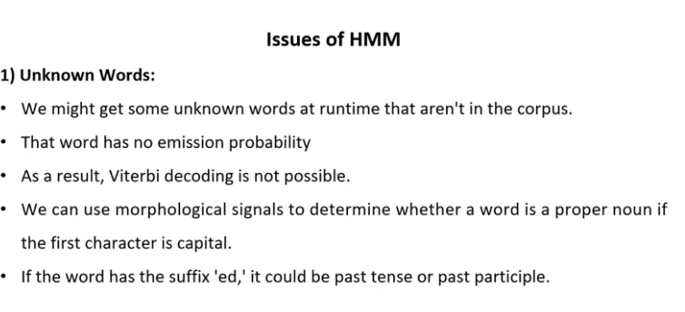

Slide 96
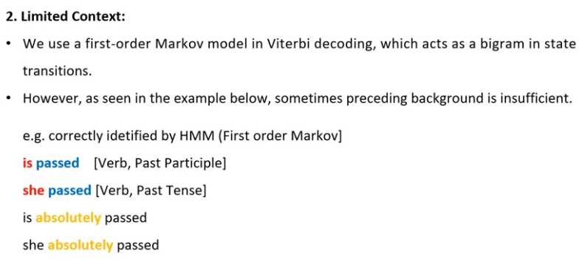

Slide 97
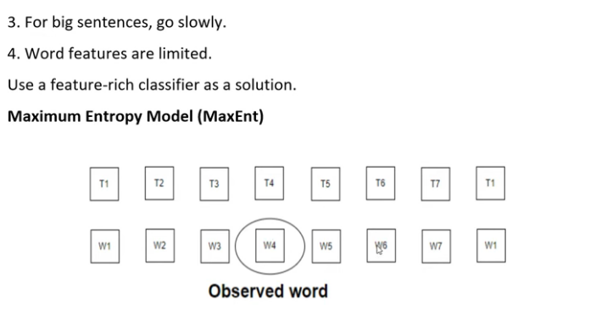

Slide 98
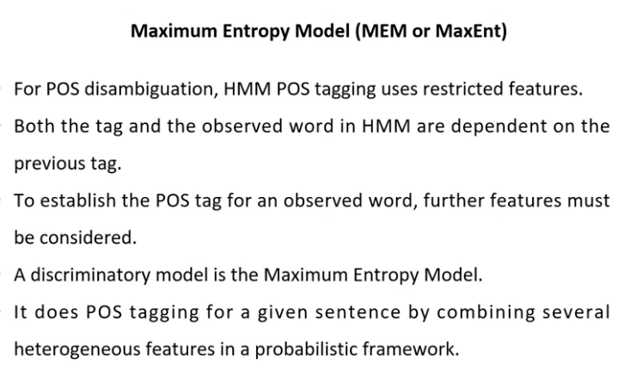

Slide 99
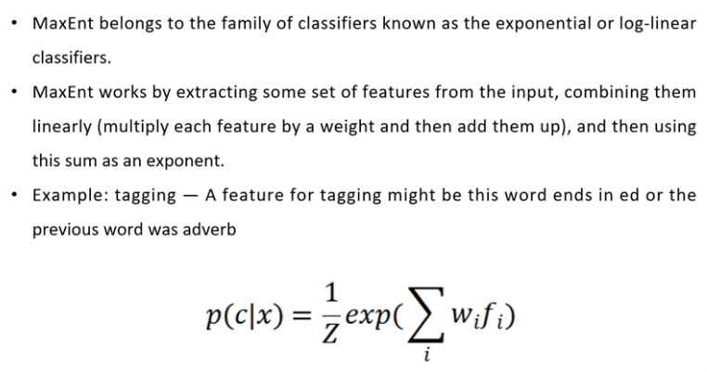

Slide 100
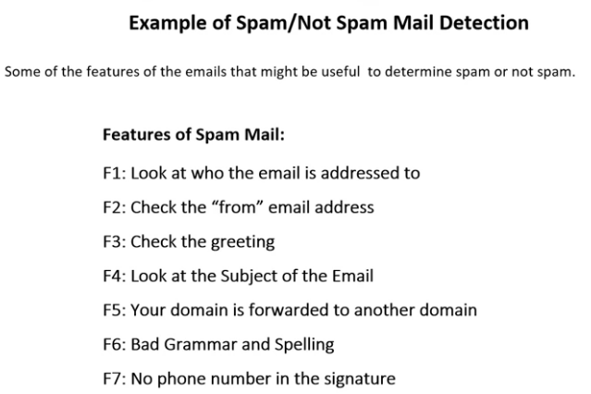

Slide 101
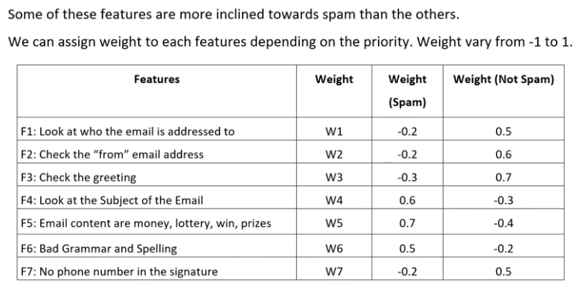

Slide 102
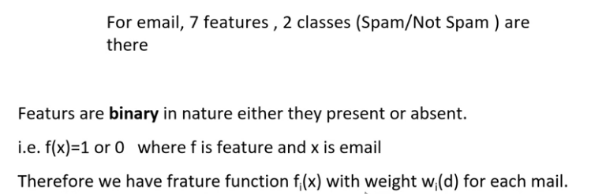

Slide 103
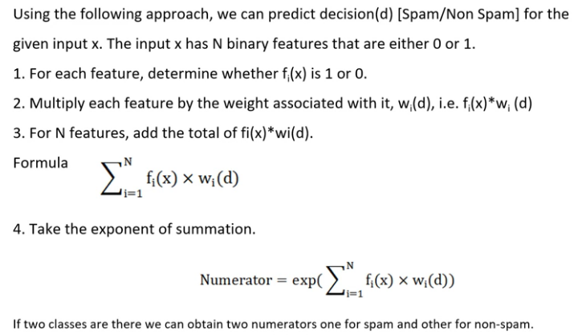

Slide 104
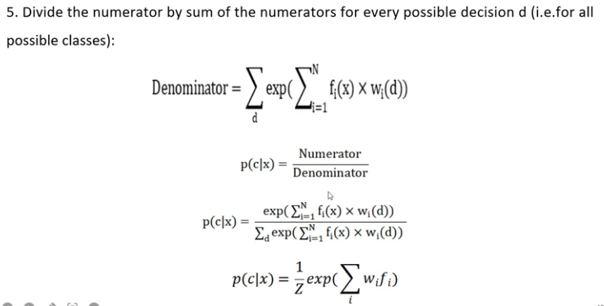

Slide 105
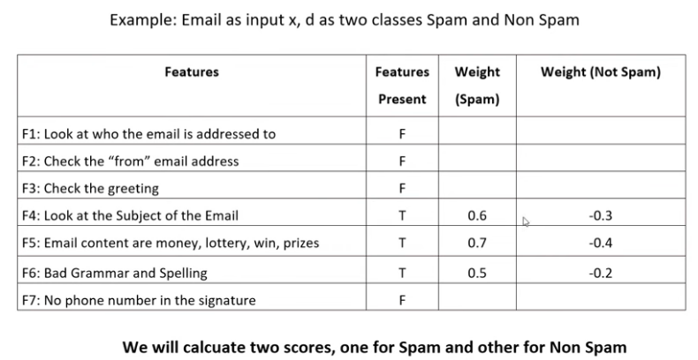

Slide 106
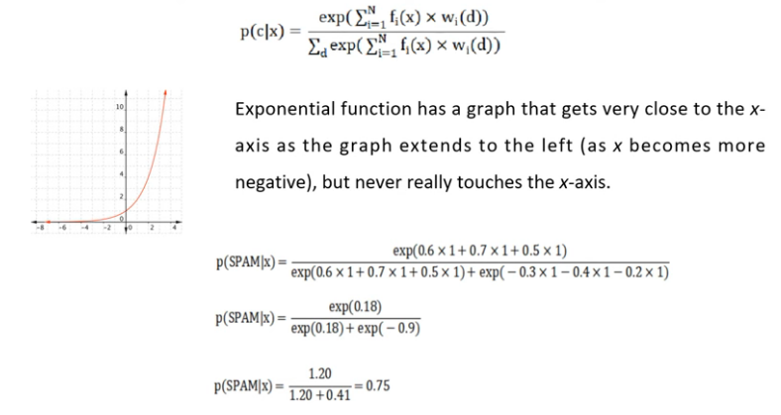

Slide 107
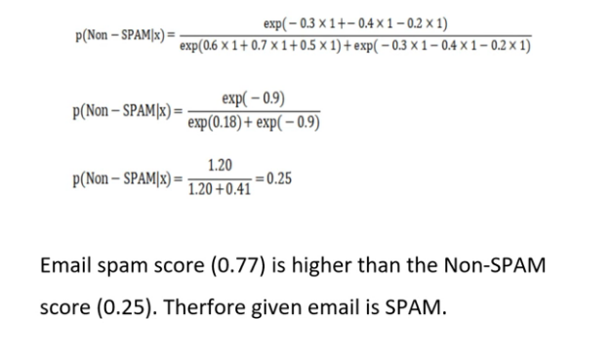

Slide 108
Features in MaxEnt
Word identity: Is the word “the”?
Prefix/suffix: Does it end in “-ing”?
Capitalization: Is it uppercase?
Previous and next tags.

Slide 109
MaxEnt Example
Sentence: “Dogs bark loudly.”
Features:
Current word = “Dogs” → likely Noun.
Starts with capital → proper noun or sentence start.
Next word = verb → increases probability for Noun.

Slide 110
MaxEnt vs. HMM
Feature | HMM | MaxEnt
Model type | Generative | Discriminative
Uses features | Limited | Rich, flexible
Long dependencies | Weak | Strong
Data requirements | Less | More

